Slide 1
Where to open Fitness Center
Deep Chatterjee

Slide 2
Introduction / Business Problem
New York City was home to nearly 8.5 million people in 2014.
The aim of this project is to discover where is the optimal place to build a gym in the New York City.
To answer this question we will analyse which districts have a gym and if there are any similarities between them.

Slide 3
Data
For this project we need the following data :
New York City data that contains list Boroughs, Neighborhoods along with their latitude and longitude.
Data source : https://cocl.us/new_york_dataset
Description: This data set contains the required information. And we will use this data set to
explore various neighbourhoods of new york city.
Data source: Fousquare API:
Description: By using this api we will get all the venues in each neighbourhood. We can filter these venues to get only gym/fitness-center.

Slide 4
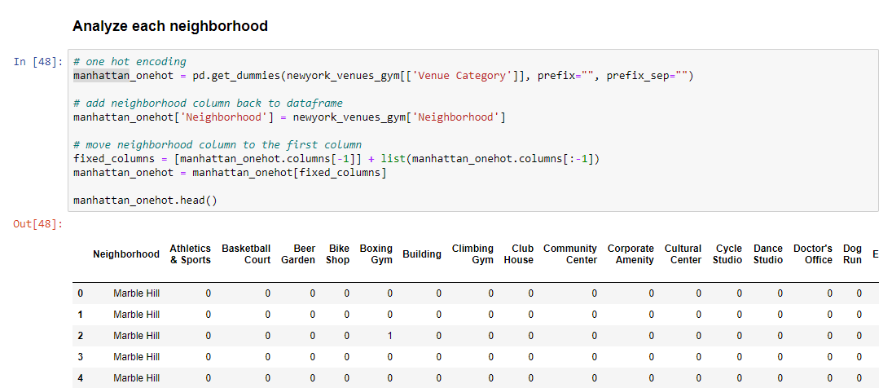
Methodology
Exploring and Cleaning Data
We need to know our data. We can do this through exploratory analysis. Once we know our data we can perform, if necessary, some cleaning (In our case we will see that it is necessary)

Slide 5
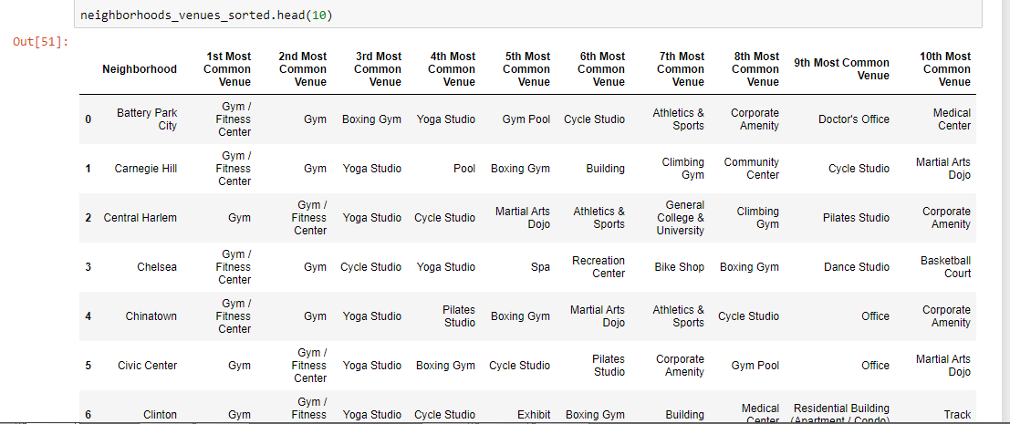
Methodology
Sorting the neighborhood
We now sort the venues

Slide 6
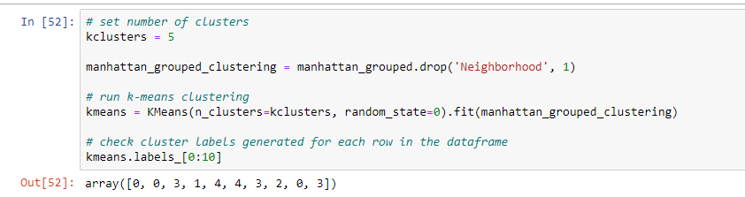
Methodology
Clustering the venues
We now use Machine Learning algorithm K-Means Clustering to cluster out present fitness centers

Slide 7
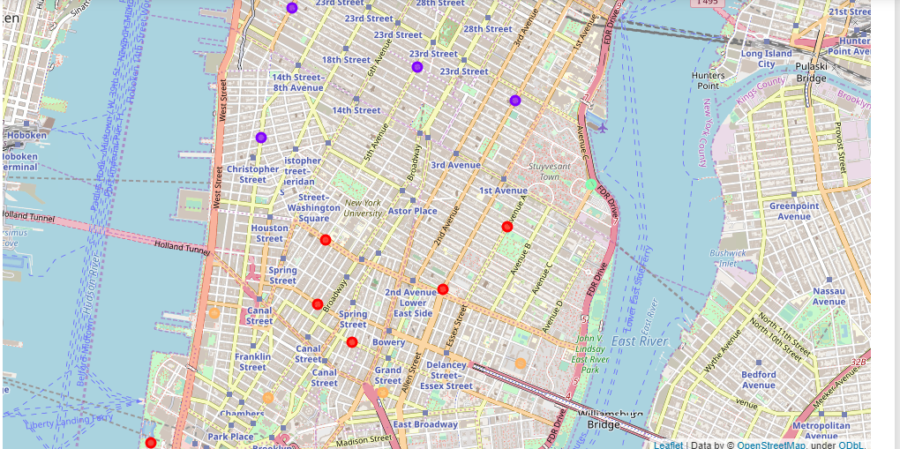
Result
After Clustering the venues we get the following map of clusters
We now use Machine Learning algorithm K-Means Clustering to cluster out present fitness centers

Slide 8
Discussion
There is high competition in Lower Manhattan so it is very risky to open business in these areas.
Soho and East Village have potential to open new centres.
The above analysis is performed on limited data. Hence, it may be not very accurate. So, if good amount of data is available there is scope to come up with better results.

Slide 9
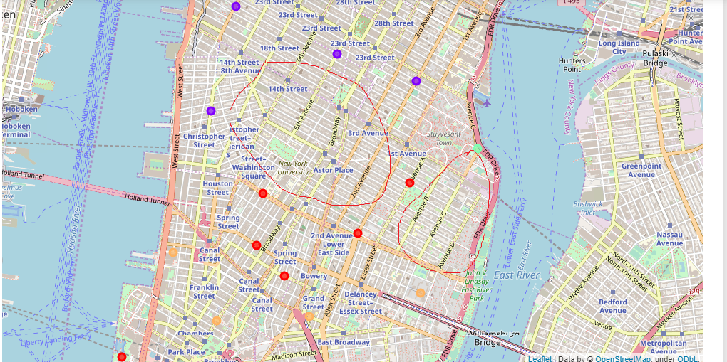
Conclusion
Below Circled areas can be considered as to open new Gym/Fitness Center

Slide 10
Thank you

